Slide 1
Random Variables and their Probability Distributions
Programming and Data Analysis for Modern Neuroscience
Spring 2020

Slide 2

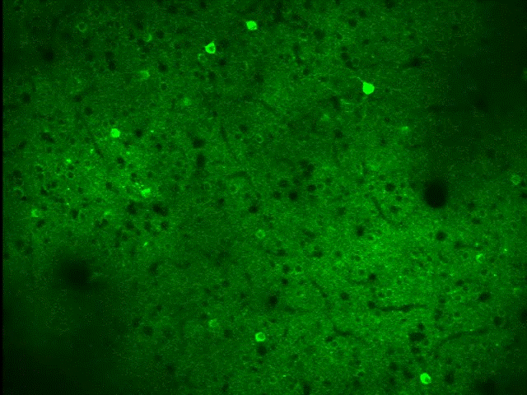
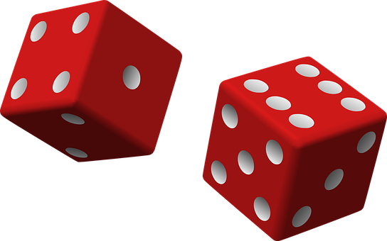
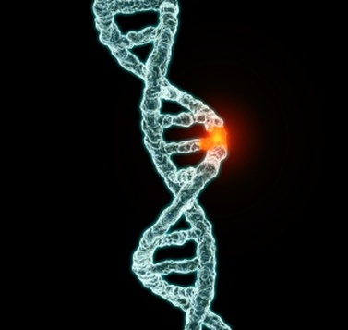

Random Variables

Slide 3
Probability Distributions
Probability
19%
50%
1%
30%
Random Variable:
Tomorrow’s weather

Slide 4
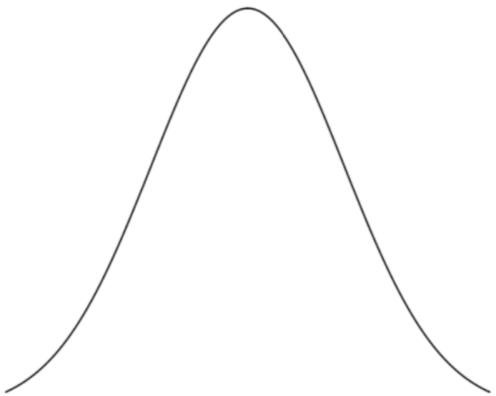
A Random Variable X Can Be of Two Types:
Discrete
Continuous
Probability Density
Function (pdf)
Probability
X→
A
B
C
D
X

Slide 5
A Random Variable X Can Be of Two Types:
Discrete
Continuous
Probability Density
Function (pdf)
Probability
X→
A
B
C
D
X
e.g. Counting: How many cells/spikes?
e.g. Classification: Which cell type?
e.g. Measurement: Membrane Voltage, Synapse Volume, Ca²⁺ Concentration, etc.

Slide 6
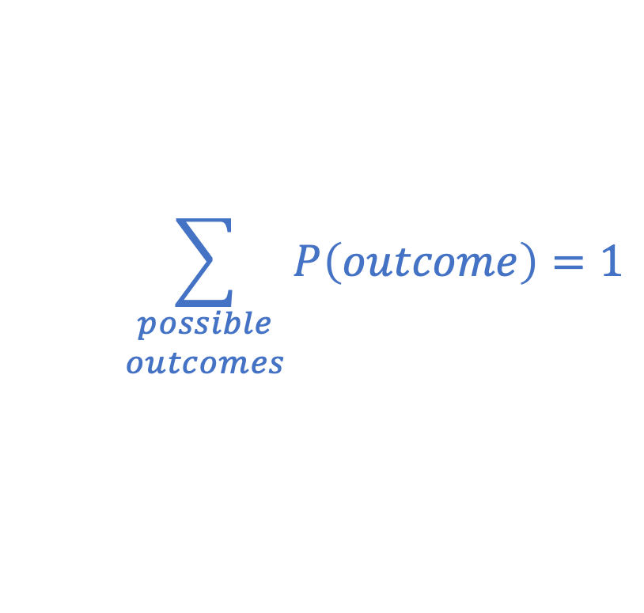
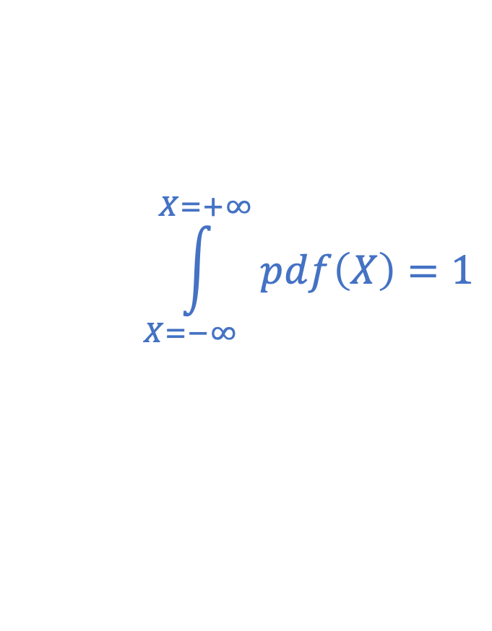
Sum of the Probability of All Possibilities = 1
Discrete
Continuous
Probability Density
Function (pdf)
Probability
X→
A
B
C
D
X
$$\sum_{\begin{matrix}possible \\ outcomes\end{matrix}}{P\left(outcome\right)}=1$$
$$\int_{X=−∞}^{X=+∞}{pdf\left(X\right)}=1$$

Slide 7
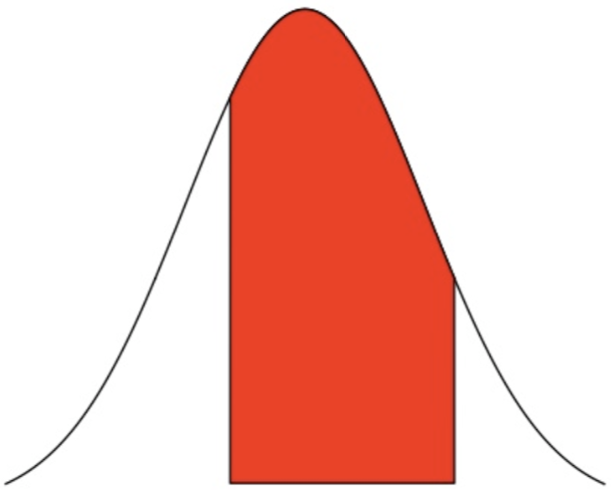
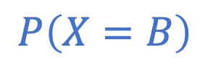
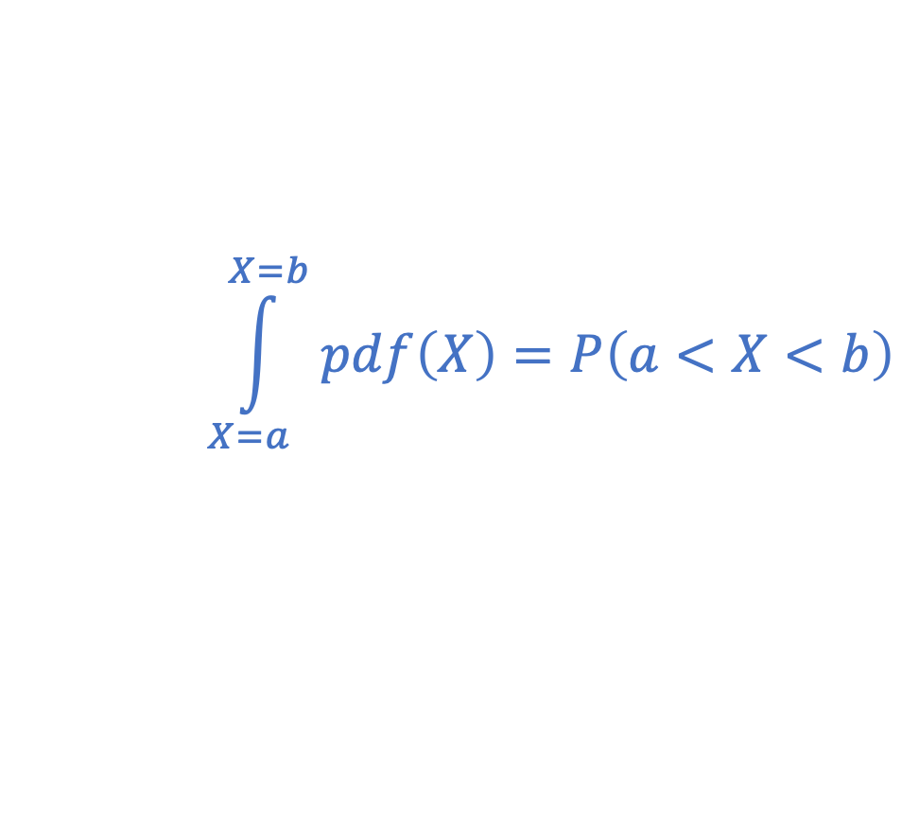
Probability vs. Probability Density
Discrete
Continuous
Probability Density
Function (pdf)
Probability
X→
A
B
C
D
X=a
X=b
$$\int_{X=a}^{X=b}{pdf\left(X\right)}=P\left(a<X<b\right)$$
$$P\left(X=B\right)$$

Slide 8
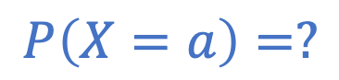
Probability vs. Probability Density
Discrete
Continuous
Probability Density
Function (pdf)
Probability
X→
A
B
C
D
X=a
$$P\left(X=B\right)$$
$$P\left(X=a\right)=?$$

Slide 9
Probability vs. Probability Density
Discrete
Continuous
Probability Density
Function (pdf)
Probability
X→
A
B
C
D
X=a
$$P\left(X=B\right)$$
$$P\left(X=a\right)=?$$

Slide 10
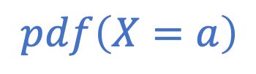
Probability vs. Probability Density
Discrete
Continuous
$$pdf\left(X=a\right)$$
Probability Density
Function (pdf)
Probability
X→
A
B
C
D
X=a
$$P\left(X=B\right)$$
$$P\left(X=a\right)=?$$

Slide 11
Probability Mass Function (pmf)
Discrete
Continuous
Probability Mass
Function (pmf)
Probability Density
Function (pdf)
X→
A
B
C
D
X
A discrete probability distribution is referred to as a probability mass function (pmf).

Slide 12
Cumulative Density Function (cdf)
area

Slide 13
Survival Function = 1 - cdf
SF(x=1)
area
CDF(x=1)

Slide 14
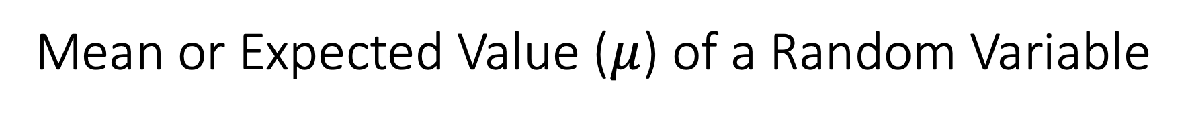
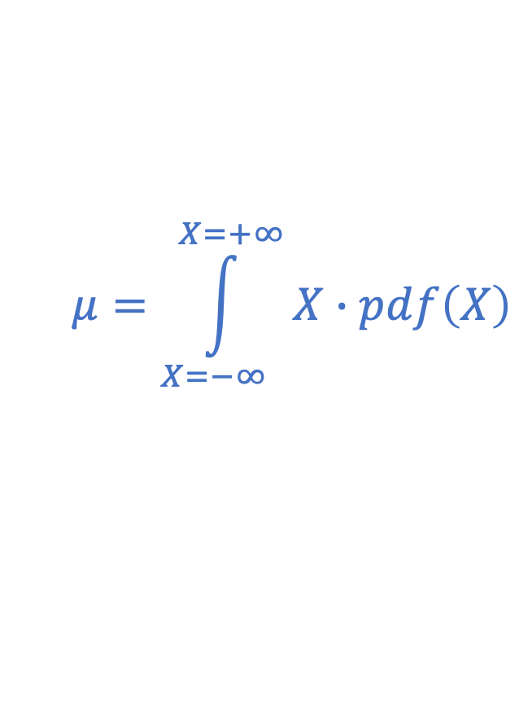
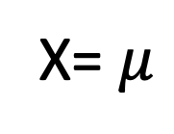
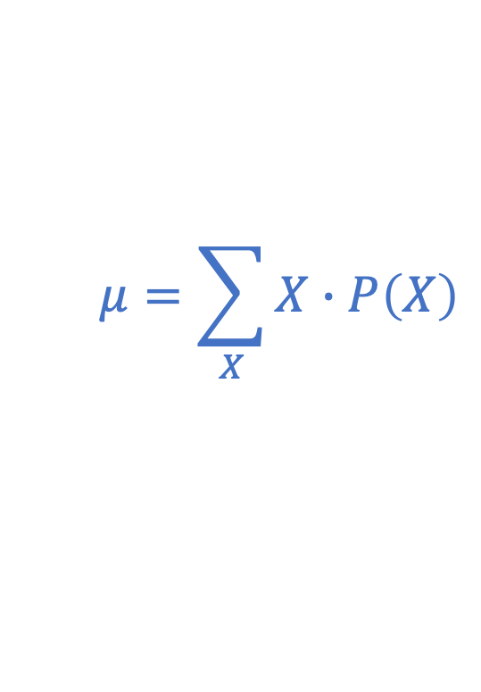
Mean or Expected Value ($μ$) of a Random Variable
Discrete
Continuous
Probability Density
Function (pdf)
Probability
X→
A
B
C
D
X= $μ$
$$μ=\sum_{X}{X∙P\left(X\right)}$$
$$μ=\int_{X=−∞}^{X=+∞}{X∙pdf\left(X\right)}$$

Slide 15
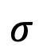
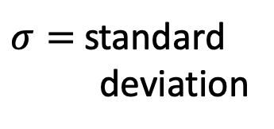
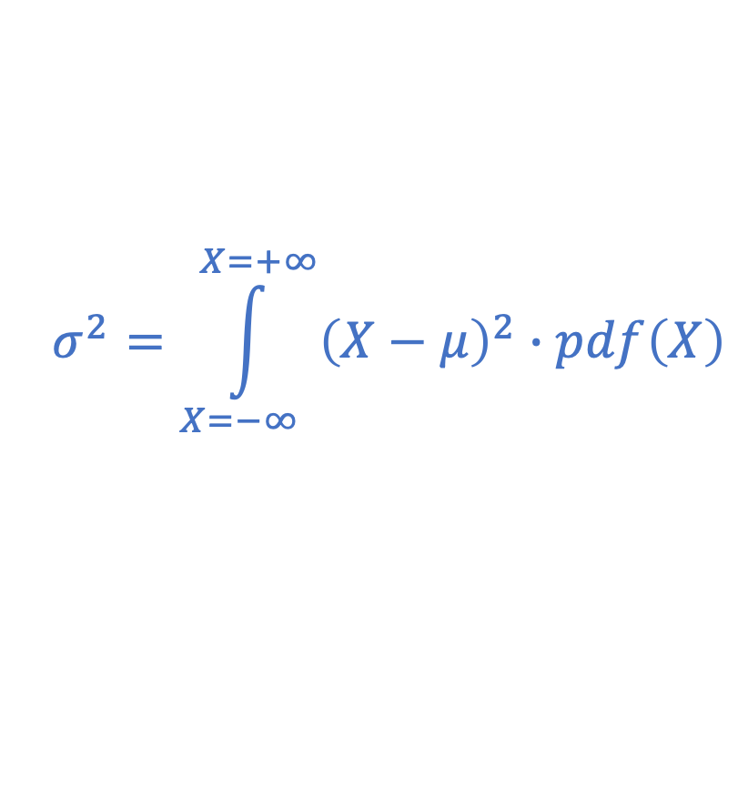
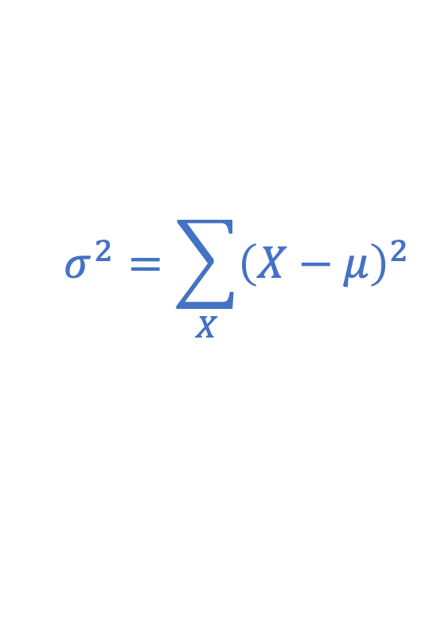
Variance ($σ^{2}$) of a Random Variable about its mean
Discrete
Continuous
$$σ$$
Probability Density
Function (pdf)
$σ=$ standard
deviation
Probability
X→
A
B
C
D
X= $μ$
$$σ^{2}=\sum_{X}{{\left(X−μ\right)}^{2}}$$
$$σ^{2}=\int_{X=−∞}^{X=+∞}{{\left(X−μ\right)}^{2}∙pdf\left(X\right)}$$

Slide 16
A Few Common Distributions Worth Knowing
Binomial Distribution: Multiple trials consisting of a binary choice.
Poisson Distribution: Number of events in an interval of time or space.
Exponential Distribution: Interval (e.g. time) between random events.
Normal Distribution: Random fluctuations about a mean.
Boltzmann Distribution: Probability of a system being in a particular energy state.

Slide 17
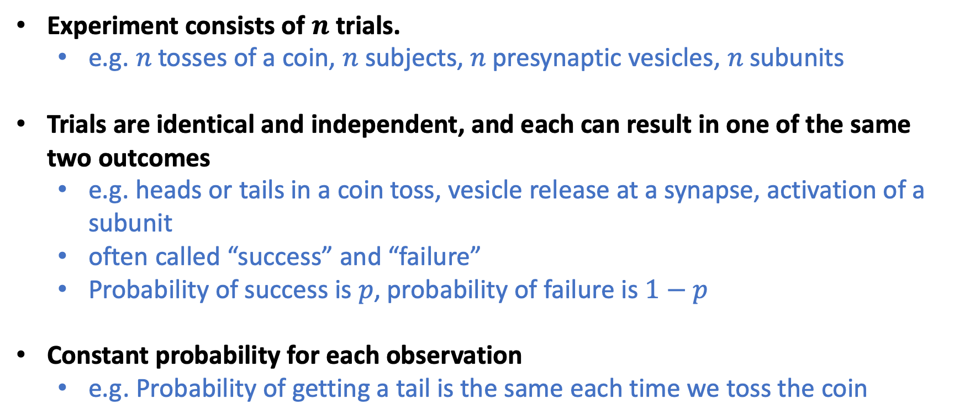
Binomial Distribution
Experiment consists of $n$ trials.
e.g. $n$ tosses of a coin, $n$ subjects, $n$ presynaptic vesicles, $n$ subunits
Trials are identical and independent, and each can result in one of the same two outcomes
e.g. heads or tails in a coin toss, vesicle release at a synapse, activation of a subunit
often called “success” and “failure”
Probability of success is $p$, probability of failure is $1−p$
Constant probability for each observation
e.g. Probability of getting a tail is the same each time we toss the coin

Slide 18
Binomial Distribution
Probability of 2 out of 3 Heads?
1st toss
2nd toss
3rd toss

Slide 19
Binomial Distribution
Probability of 2 out of 3 Heads?
Fair coin
1st toss
2nd toss
3rd toss
p(0 Heads) = 1 * 0.5³ = 0.125
p(1 Heads) = 3 * 0.5³ = 0.375
p(2 Heads) = 3 * 0.5³ = 0.375
p(3 Heads) = 1 * 0.5³ = 0.125
0.5³
0.5²
0.5³
0.5
0.5³
0.5²
0.5³
0.5³
0.5²
0.5³
0.5
0.5³
0.5²
0.5³

Slide 20
Binomial Distribution
Probability of 2 out of 3 Heads?
Fair coin
Biased coin (40% Heads)
1st toss
2nd toss
3rd toss
p(0 Heads) = 1 * 0.5³ = 0.125
p(1 Heads) = 3 * 0.5³ = 0.375
p(2 Heads) = 3 * 0.5³ = 0.375
p(3 Heads) = 1 * 0.5³ = 0.125
p(0 Heads) = 1 * 0. 6³ = 0.216
p(1 Heads) = 3 * 0.4 * 0.6² = 0.432
p(2 Heads) = 3 * 0.4² * 0.6 = 0.288
p(3 Heads) = 1 * 0.4³ = 0.064
0.5³
0.4³
0.5²
0.4²
0.5³
0.4² * 0.6
0.5
0.4
0.5³
0.4² * 0.6
0.5²
0.4*0.6
0.5³
0.4 * 0.6²
0.5³
0.4² * 0.6
0.5²
0.6*0.4
0.5³
0.4 * 0.6²
0.5
0.6
0.5³
0.4 * 0.6²
0.5²
0.6²
0.5³
0.6³

Slide 21
Binomial Distribution
# of ways to get 2 heads out of 3 tosses
(p_{Heads})² * (p_{Tails})¹
= (p_{Heads})² * (1 - p_{Heads})¹
Probability of 2 out of 3 Heads?
Fair coin
Biased coin (40% Heads)
1st toss
2nd toss
3rd toss
p(0 Heads) = 1 * 0.5³ = 0.125
p(1 Heads) = 3 * 0.5³ = 0.375
p(2 Heads) = 3 * 0.5³ = 0.375
p(3 Heads) = 1 * 0.5³ = 0.125
p(0 Heads) = 1 * 0. 6³ = 0.216
p(1 Heads) = 3 * 0.4 * 0.6² = 0.432
p(2 Heads) = 3 * 0.4² * 0.6 = 0.288
p(3 Heads) = 1 * 0.4³ = 0.064
0.5³
0.4³
0.5²
0.4²
0.5³
0.4² * 0.6
0.5
0.4
0.5³
0.4² * 0.6
0.5²
0.4*0.6
0.5³
0.4 * 0.6²
0.5³
0.4² * 0.6
0.5²
0.6*0.4
0.5³
0.4 * 0.6²
0.5
0.6
0.5³
0.4 * 0.6²
0.5²
0.6²
0.5³
0.6³

Slide 22
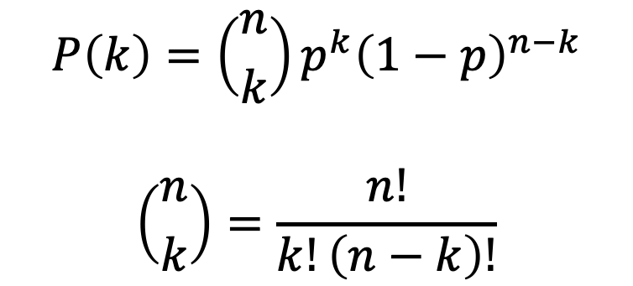
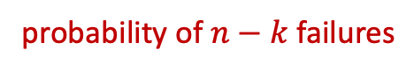
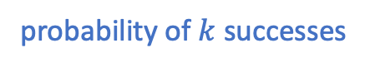
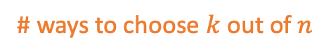
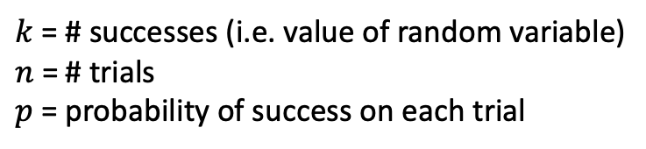
Binomial Distribution
# of ways to get 2 heads out of 3 tosses
(p_{Heads})² * (p_{Tails})¹
= (p_{Heads})² * (1 - p_{Heads})¹
Probability of 2 out of 3 Heads?
Biased coin (40% Heads)
probability of $n−k$ failures
p(0 Heads) = 1 * 0. 6³ = 0.216
p(1 Heads) = 3 * 0.4 * 0.6² = 0.432
p(2 Heads) = 3 * 0.4² * 0.6 = 0.288
p(3 Heads) = 1 * 0.4³ = 0.064
probability of $k$ successes
# ways to choose $k$ out of $n$
0.4³
$$P\left(k\right)=\left({n \atop k}\right)p^{k}{\left(1−p\right)}^{n−k}$$
$$\left({n \atop k}\right)=\frac{n!}{k!\left(n−k\right)!}$$
0.4²
0.4² * 0.6
0.4
0.4² * 0.6
0.4*0.6
0.4 * 0.6²
0.4² * 0.6
0.6*0.4
0.4 * 0.6²
0.6
$k$ = # successes (i.e. value of random variable)
$n$ = # trials
$p$= probability of success on each trial
0.4 * 0.6²
0.6²
0.6³

Slide 23
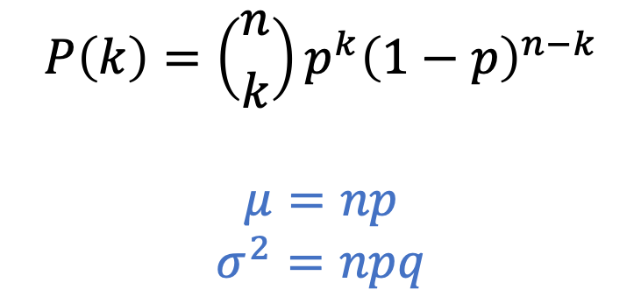
Binomial Distribution
# of ways to get 2 heads out of 3 tosses
(p_{Heads})² * (p_{Tails})¹
= (p_{Heads})² * (1 - p_{Heads})¹
Probability of 2 out of 3 Heads?
Biased coin (40% Heads)
probability of $n−k$ failures
p(0 Heads) = 1 * 0. 6³ = 0.216
p(1 Heads) = 3 * 0.4 * 0.6² = 0.432
p(2 Heads) = 3 * 0.4² * 0.6 = 0.288
p(3 Heads) = 1 * 0.4³ = 0.064
probability of $k$ successes
# ways to choose $k$ out of $n$
0.4³
$$P\left(k\right)=\left({n \atop k}\right)p^{k}{\left(1−p\right)}^{n−k}$$
$$μ=np$$
$$σ^{2}=npq$$
0.4²
0.4² * 0.6
0.4
0.4² * 0.6
0.4*0.6
0.4 * 0.6²
0.4² * 0.6
0.6*0.4
0.4 * 0.6²
0.6
$k$ = # successes (i.e. value of random variable)
$n$ = # trials
$p$= probability of success on each trial
0.4 * 0.6²
0.6²
0.6³

Slide 24
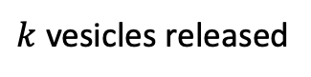
Binomial Distribution
Probability that a presynaptic input results in neurotransmitter release from $k$ vesicles given 20 available release sites and a probability of release at each site of $p$?
$k$ vesicles released

Slide 25
Binomial Distribution
Code Examples

Slide 26
Poisson Distribution
Counting the number of events in an interval (e.g time, space, population).
e.g. number of spikes in a minute, number of vesicles released for a given amount of synaptic area
Events are identical and independent - they don’t know anything about previous events.
e.g. the number of spikes in a given minute is not influenced by the number of spikes in the preceding minute
The average rate (e.g. events per time period, spatial unit, or sample size) is constant.
The Poisson distribution approximates the binomial distribution when n is large and p is small.

Slide 27
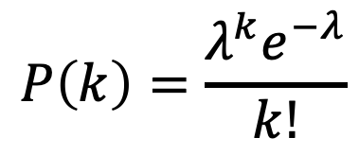
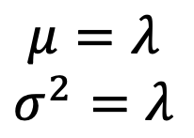
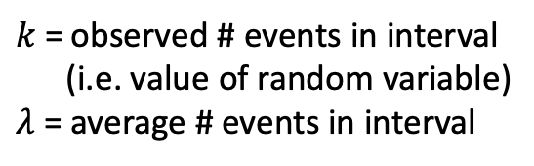
Poisson Distribution
Number of independent random events occurring at some average rate in an interval (e.g. time or space)
e.g. # of spikes in a minute, # vesicles released per unit of synaptic area
$$P\left(k\right)=\frac{λ^{k}e^{−λ}}{k!}$$
$k$ = observed # events in interval
(i.e. value of random variable)
$λ$ = average # events in interval
$$μ=λ$$
$$σ^{2}=λ$$

Slide 28
Poisson Distribution
Code Examples

Slide 29
Exponential Distribution
Interval between events occurring at a constant rate.
e.g. time between spikes, time a protein spends in a particular conformation, open/closed times of ion channels
Events are identical and independent - they don’t know anything about previous events.
e.g. the time to the next spike does not know about the time from the previous spike

Slide 30
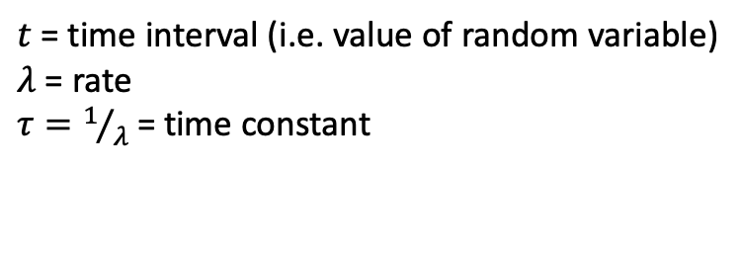
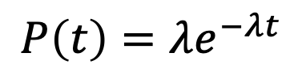
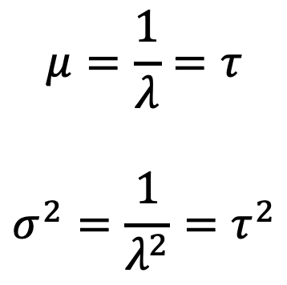
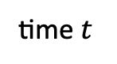
Exponential Distribution
e.g. time intervals between events occurring at an average rate, such as time between spikes, time a protein spends in a given conformation
$$P\left(t\right)=λe^{−λt}$$
$t$ = time interval (i.e. value of random variable)
$λ$ = rate
$τ=1/λ$ = time constant
Probability
$$μ=\frac{1}{λ}=τ$$
$$σ^{2}=\frac{1}{λ^{2}}=τ^{2}$$
time $t$

Slide 31
Exponential Distribution
Code Examples

Slide 32
Normal Distribution
Random fluctuations about a mean value.
The Central Limit Theorem explains why this distribution is so important.

Slide 33
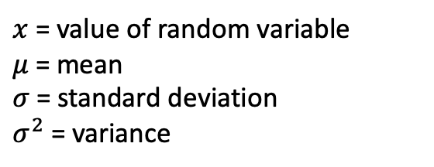
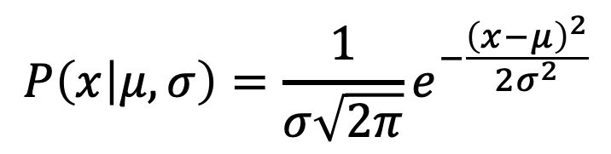
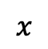
Normal Distribution
random fluctuations about a mean
$$P\left(x | μ,σ\right)=\frac{1}{σ\sqrt{2π}}e^{−\frac{{\left(x−μ\right)}^{2}}{2σ^{2}}}$$
Probability
$x$ = value of random variable
$μ$ = mean
$σ$ = standard deviation
$σ^{2}$ = variance
$$x$$

Slide 34
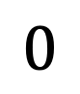
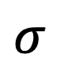
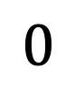
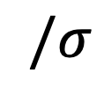
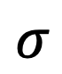
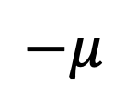
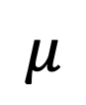
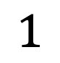
Standard Normal Distribution ($μ$=0, $σ$=1)
$$−μ$$
$$σ$$
$$σ$$
$$μ$$
$$0$$
$$/σ$$
$$1$$
$$0$$

Slide 35
Normal Distribution
Code Examples

Slide 36
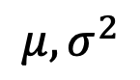
Population vs Sample
Population
$$μ, σ^{2}$$

Slide 37
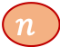
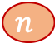
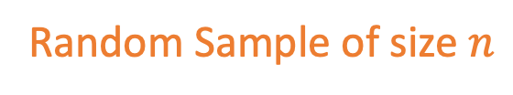
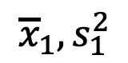
Population vs Sample
Population
$$μ, σ^{2}$$
$${\overline{x}}_{1},s_{1}^{2}$$
Random Sample of size $n$
$$n$$
$$n$$

Slide 38

Population vs Sample
Population
$$μ, σ^{2}$$
$${\overline{x}}_{1},s_{1}^{2}$$
Random Sample of size $n$
$$n$$
$$n$$
$${\overline{x}}_{1}=μ ?$$
$$s_{1}=σ ?$$
Probably NOT

Slide 39








Population vs Sample
Population
$$μ, σ^{2}$$
$$n$$
$$n$$
Random Sample of size $n$
$$n$$
$${\overline{x}}_{1},s_{1}^{2}$$
$$n$$
$$n$$
$$n$$
$${\overline{x}}_{2},s_{2}^{2}$$
Another Sample of size $n$
$${\overline{x}}_{3},s_{3}^{2}$$
Another Sample of size $n$
$$n$$
.
.
.

Slide 40

Population vs Sample
Population
$$μ, σ^{2}$$
$$n$$
$$n$$
Random Sample of size $n$
$$n$$
$${\overline{x}}_{1},s_{1}^{2}$$
$$n$$
$$n$$
$$n$$
$${\overline{x}}_{2},s_{2}^{2}$$
Another Sample of size $n$
$${\overline{x}}_{3},s_{3}^{2}$$
Another Sample of size $n$
$$n$$
.
.
.
$${\overline{x}}_{1}={\overline{x}}_{2}={\overline{x}}_{3}=… ?$$
$$s_{1}=s_{2}=s_{3}=… ?$$
Probably NOT

Slide 41
Population vs Sample
Population
$$μ, σ^{2}$$
$$n$$
$$n$$
Random Sample of size $n$
$$n$$
$${\overline{x}}_{1},s_{1}^{2}$$
$$n$$
$$n$$
$$n$$
$${\overline{x}}_{2},s_{2}^{2}$$
Another Sample of size $n$
$${\overline{x}}_{3},s_{3}^{2}$$
Another Sample of size $n$
$$n$$
.
.
.
Any statistic (e.g. mean, variance, etc.) has a distribution across samples.

Slide 42







Central Limit Theorem
As the sample size $n$ get bigger ($n≥30$ is often, although not always big enough), the distribution of sample means $μ_{i}$ will tend towards a normal distribution about the population mean $μ$ with variance ${σ^{2}}/n$.
!!! This works even if the population distribution is NOT itself normal. It can be almost anything!
Population
$$μ, σ^{2}$$
$$n$$
$$n$$
$$n$$
$${\overline{x}}_{1},s_{1}^{2}$$
$$n$$
$$n$$
$$n$$
$${\overline{x}}_{2},s_{2}^{2}$$
$$n$$
$${\overline{x}}_{3},s_{3}^{2}$$
.
.
.
Any statistic (e.g. mean, variance, etc.) has a distribution across samples.
$${\overline{x}}_{1}$$
$${\overline{x}}_{2}$$
$${\overline{x}}_{3}$$
$$μ−\frac{σ}{\sqrt{n}}$$
$$μ$$
$$μ+\frac{σ}{\sqrt{n}}$$

Slide 43

Central Limit Theorem

Slide 44
Central Limit Theorem
Normal-ish distributions are everywhere. Consider a complicated biological processes where the parameter that you measure results from the average of multiple underlying processes. By the central limit theorem we might expect our measurements to have a normal distribution even if the underlying processes do not.
Population
$$μ, σ^{2}$$
$$n$$
$$n$$
$$n$$
$${\overline{x}}_{1},s_{1}^{2}$$
$$n$$
$$n$$
$$n$$
$${\overline{x}}_{2},s_{2}^{2}$$
$$n$$
$${\overline{x}}_{3},s_{3}^{2}$$
.
.
.
Any statistic (e.g. mean, variance, etc.) has a distribution across samples.
$${\overline{x}}_{1}$$
$${\overline{x}}_{2}$$
$${\overline{x}}_{3}$$
$$μ−\frac{σ}{\sqrt{n}}$$
$$μ$$
$$μ+\frac{σ}{\sqrt{n}}$$

